Slide 1
SYNONYMS
Milind Parab

Slide 2
Sample.
Once Synonyms created can not be altered. You have to drop the synonym.
There are two types of Synonym 1 Local and 2. Public.
Public Schema need only Synonym name. But Local need Schema and Synonym both.
If you drop source table with restricted delete, only table will be dropped. If you drop with cascade delete, synonym will be dropped along with table.

Slide 3
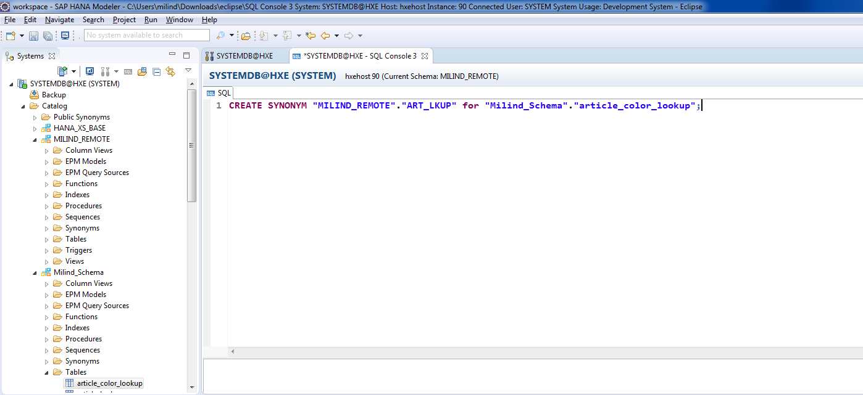
Create Private Synonym.

Slide 4
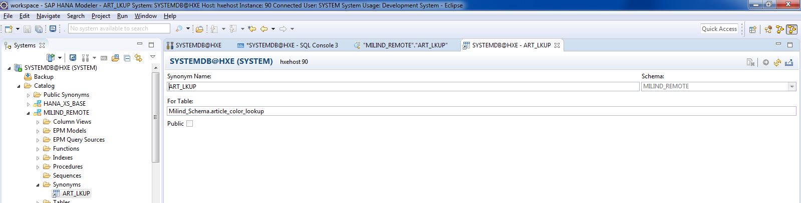
Source and Destination Table.

Slide 5
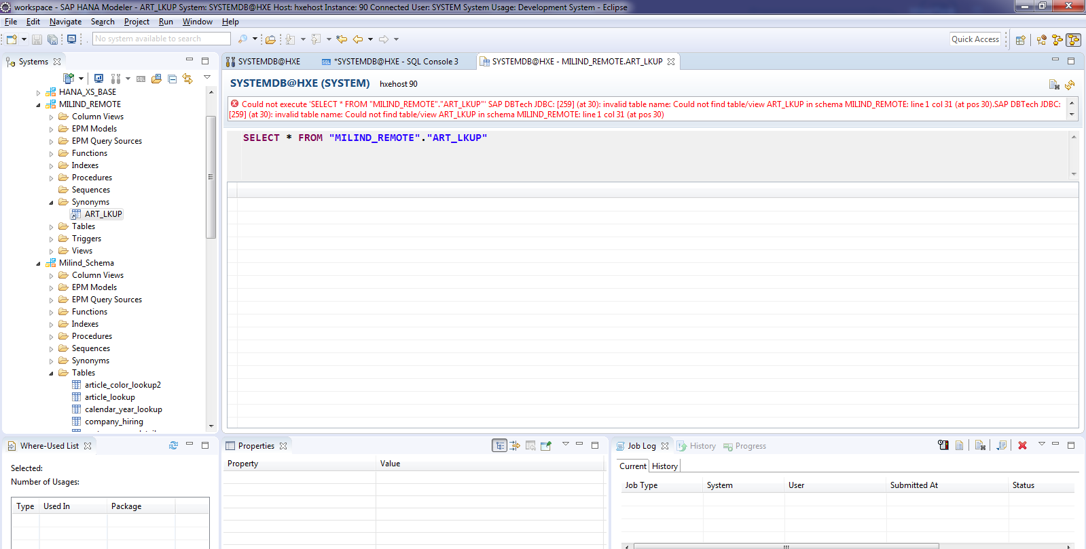
If you drop the source table. Synonym would be invalid.

Slide 6
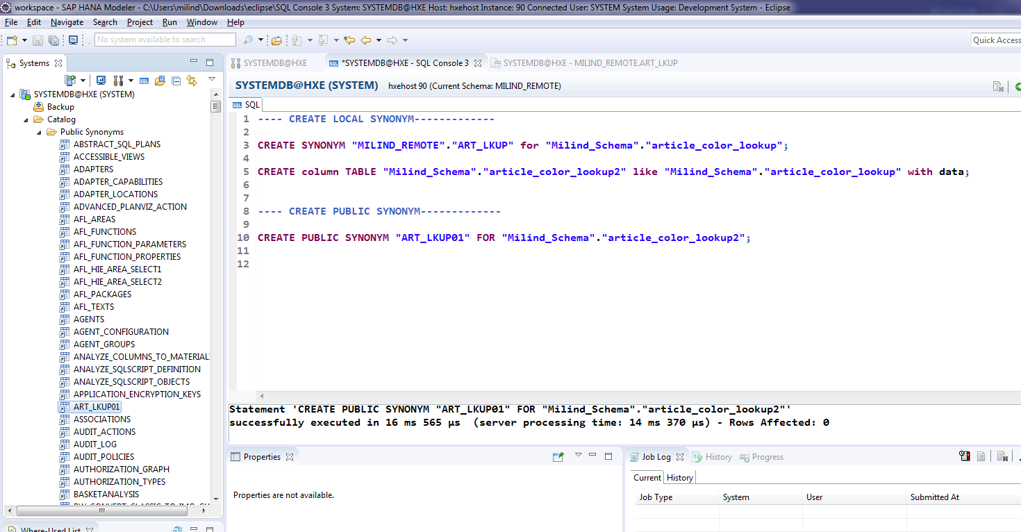
Public Synonym.

Slide 7
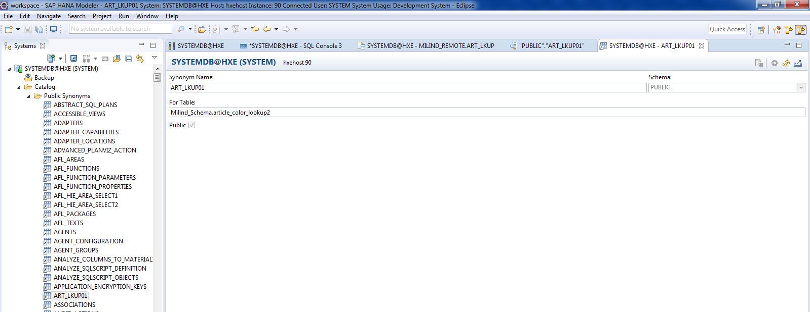
Cont.

